Slide 1

Computer Architecture
Keivan Navi
Cal Poly Pomona University
knavi@cpp.edu
Office hours: Tu/Th 5:25 Pm to 6:55 Pm
Office: 8-49

Slide 2
Computer Architecture
Half Adder Full Adder
Addition Subtraction

Slide 3
Half Adder (HA)
A half adder is a digital logic circuit that performs binary addition of two single-bit binary numbers. It has two inputs, A and B, and two outputs, SUM and CARRY. The SUM output is the least significant bit (LSB) of the result, while the CARRY output is the most significant bit (MSB) of the result, indicating whether there was a carry-over from the addition of the two inputs. The half adder can be implemented using basic gates such as XOR and AND gates.

Slide 4
Half Adder (Continued)
The half adder is a basic building block for more complex adder circuits such as full adders and multiple-bit adders. It performs binary addition of two single-bit inputs, A and B, and provides two outputs, SUM and CARRY.
The SUM output is the least significant bit (LSB) of the result, which is the XOR of the two inputs A and B. The XOR gate implements the addition operation for binary digits, where a “1” is generated in the SUM output only when one of the inputs is “1”.
The CARRY output is the most significant bit (MSB) of the result, indicating whether there was a carry-over from the addition of the two inputs. The CARRY output is the AND of the two inputs A and B. The AND gate generates a “1” in the CARRY output only when both inputs are “1”.
Half adder is the simplest of all adder circuits. Half adder is a combinational arithmetic circuit that adds two numbers and produces a sum bit (s) and carry bit (c) both as output. The addition of 2 bits is done using a combination circuit called a Half adder. The input variables are augend and addend bits and output variables are sum & carry bits. A and B are the two input bits.

Slide 5
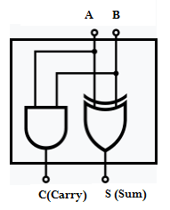
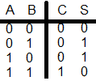

Half Adder
A Half Adder (HA) adds 2 bits:
C (Carry) = AB (A and B)
S (Sum) = A’B + AB’ (A xor B) =

Slide 6
Positional Value
In arithmetic, positional value, also known as place value, is the value of a digit in a number that depends on its position in the number:
In a positional system, the value of a digit is the product of the digit and its place value. The place value is determined by the digit's position in the number. The total value of the number is the sum of the products of each digit and its place value.

Slide 7
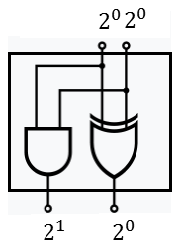
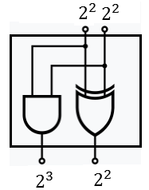
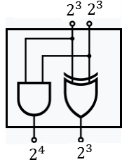
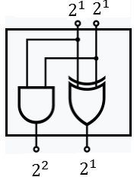
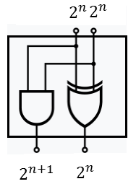
Positional Value
What is the positional value?

Slide 8
Full Adder (FA)
Full Adder is the adder that adds three inputs and produces two outputs. The first two inputs are A and B and the third input is an input carry as C-IN. The output carry is designated as C-OUT and the normal output is designated as S which is SUM. The C-OUT is also known as the majority 1’s detector, whose output goes high when more than one input is high. A full adder logic is designed in such a manner that can take eight inputs together to create a byte-wide adder and cascade the carry bit from one adder to another. we use a full adder because when a carry-in bit is available, another 1-bit adder must be used since a 1-bit half-adder does not take a carry-in bit. A 1-bit full adder adds three operands and generates 2-bit results.
What is the positional values of each input?
If they are the same can we conclude that C-in is just a name?

Slide 9
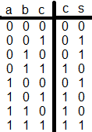
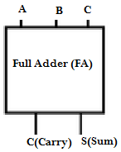
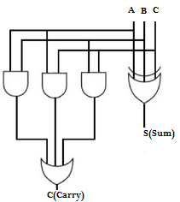
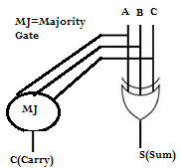
Full Adder (continued)
A Full Adder adds 3 bits:

Slide 10
Ripple adder
A ripple adder, also known as a ripple carry adder (RCA), is a circuit that adds two binary numbers together using a series of full adders, Chaining full adders together, with the carry out of each stage acting as the carry in of the next stage.
It has a simple layout and fast design time and low power consumption. It is slower than Carry Look Ahead adder, Carry Manchester Chain and Carry select adder but today power dissipation is very important and in some applications it is considered as a key issue.

Slide 11
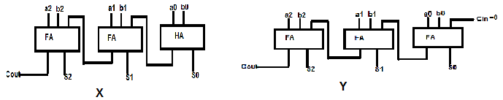
Ripple Adder (continued)
Two different design for the ripple adder:
X uses one Half Adder and the rest are Full Adder but Y use only Full Adders.

Slide 12
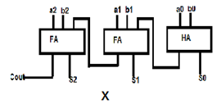
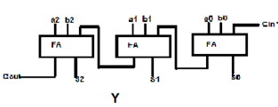
Which one is better?
This design: Is faster, consumes less power needs less chip area.
This design is regular from fabrication point of view and is cascadable:

Slide 13

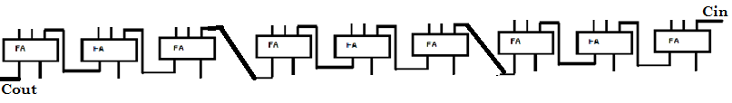
Cascadaple Adders
6bit Adder using two 3bit Adders:
9bit Adder Using three 3bit Adders:

Slide 14
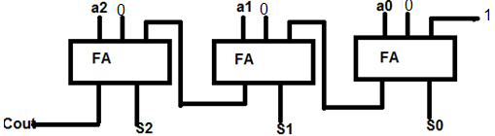
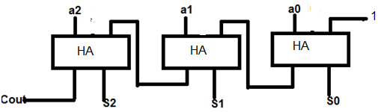
A+1
This circuit adds two numbers and adds 1 to the result: A+1
This circuit adds 1 to a number: A+1

Slide 15
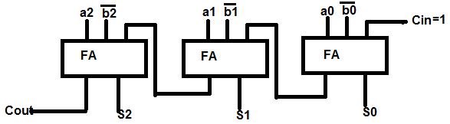
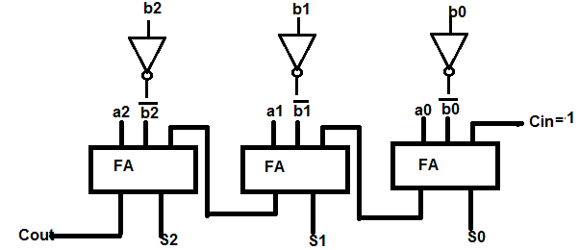
Subtraction
This circuits subtracts two numbers, A-B:

Slide 16
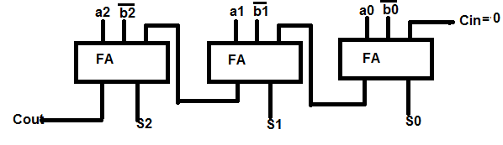
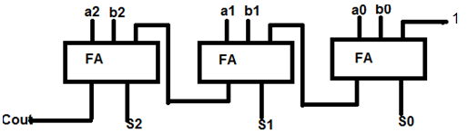
A-B-1, A+B+1
This circuit subtracts two numbers and then subtracts 1 from the result: A-B-1
This circuit adds two numbers then adds 1 to the result: A+b+1

